Slide 1
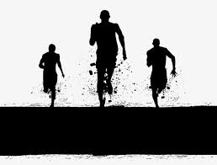
Get Fit, Get Lit
PRESENTED BY:
HANNAH ANDREWS
CODY BUCKLEY
FREDDY CURIEL
ZACK DOMINGUEZ
REINIER ESCALONA

Slide 2

Summary
Fitness application
Aimed to aid in the users fitness journey
Allows the user to input daily information about their journey
Dietary tracking with calorie counter and water intake progress
Application allows users to make a profile and save their data to their specific profile

Slide 3
Overview
Login Screen
The Login screen will initially ask for the a username and password and if none exist on fill sends an error message bringing them back to the page and access the create account function. Then during initial login it asks the user to provide statistics for the calorie calculator, which would be skipped.
Home Screen
On the Home screen our product contains the goal amount of calories left for the week, a quote of the day, and fitness videos and dieting video’s with an about us at the very bottom.
Profile Screen
On the Profile screen we have their login information including Name, age, height, weight, and email along with an edit and save button at the bottom. Then we also have a chart with the calculated goals generated by the information entered at the login screen.
Diary
The Diary screen contains a calendar with the food that was picked out and consumed for each day.
Foods Screen
The Foods screen has an interactive database that provides foods available to choose from for your diet based on your preferences, previous picks, and precalculated meals.
Sign Out Message Screen
The Sign Out Message screen directs the user to a webpage with a confirmation, or unsuccessful attempt, of their sign out attempt.

Slide 4
Member Roles & Effort:
Hannah Andrews: Manager and Front End
Effort: Made 3 scenes, worked to come up with meeting times, as well as worked on powerpoints
Cody Buckley: Float between Front End and Back End
Effort: Worked to mesh up existing slides with backend and helped front end
Freddy Curiel: Back End and making sure both sides blend together
Effort: Developed back end as well as worked on developing the database
Zack Dominguez: Design and Back End development
Effort: Developed two scenes and helped with the layout of others
Reinier Escalona: Front End and making sure Back End work efficiently with Front End
Effort: Created front end scenes and worked on powerpoints
Time Spent: ~50 hours

Slide 5
Video Example
https://www.youtube.com/watch?v=A8nGhimr3i4&feature=youtu.be

Slide 6
Legacy

Slide 7
Known Issues
Figuring out spacing and configuration for certain scenes with various elements
Trying to seamlessly transition the items from the database into a tableview with different elements
Re-sizing issues with scene elements

Slide 8
Requirements and Testing
Initial testing: Black Box Testing
Final testing: White Box Testing

Slide 9
Challenges, Issues, and Lessons learned
Communication between front and back end.
Time management during development
Use visual representations for design
splitting up work between roles

Slide 10

Questions?

Slide 11
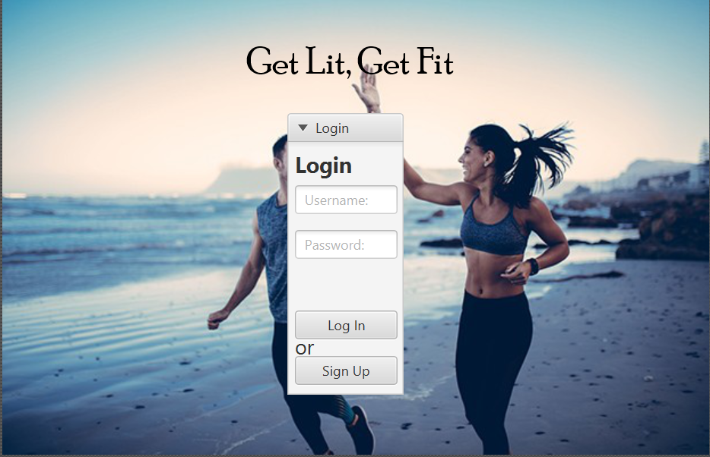
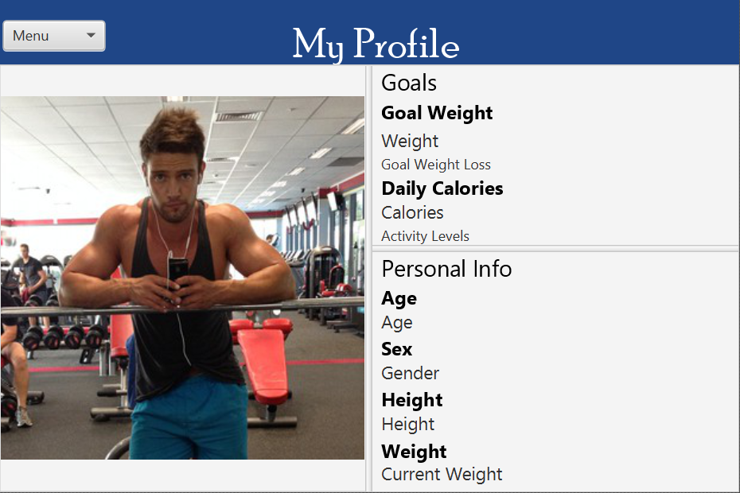
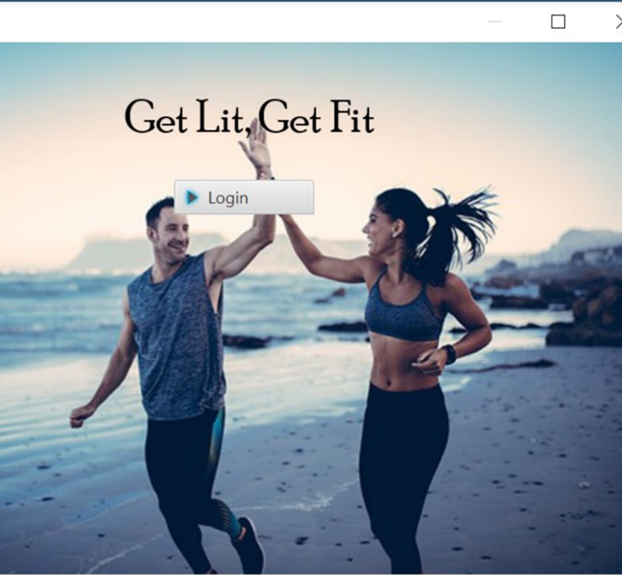
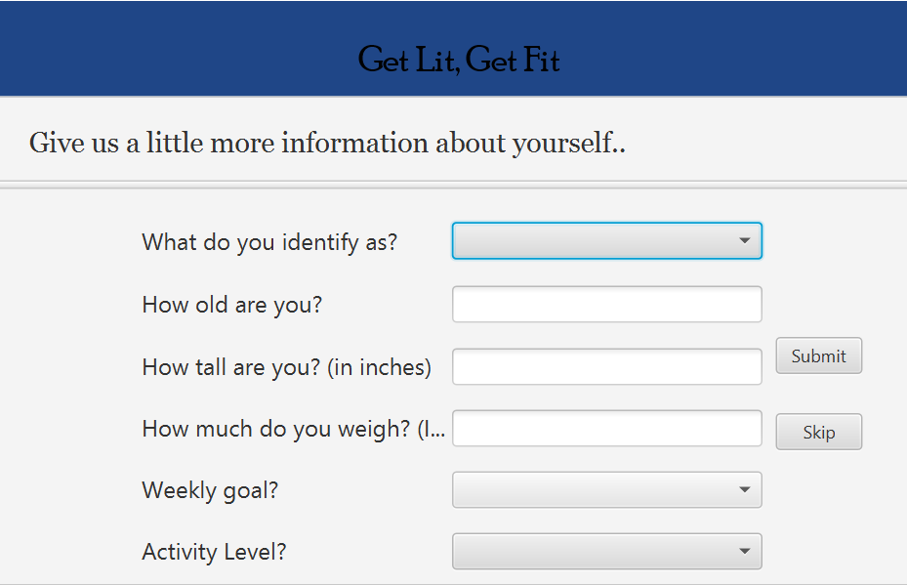
Page View

Slide 12
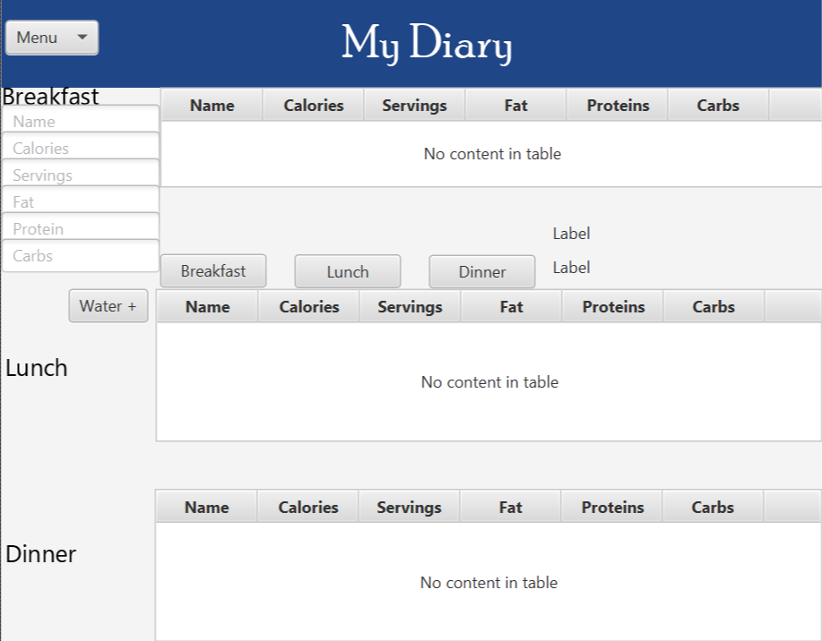
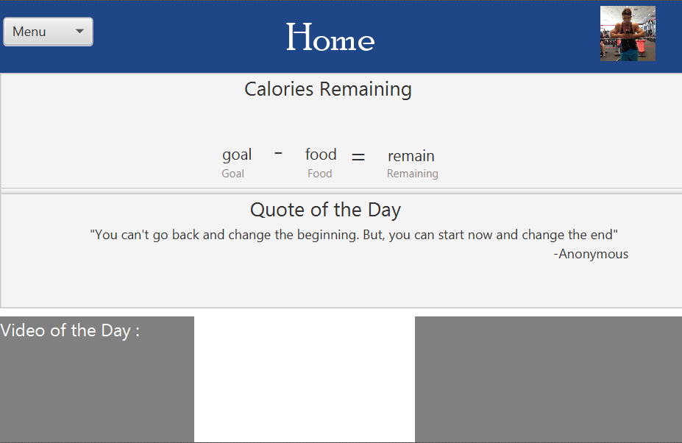
Page View

